Slide 1
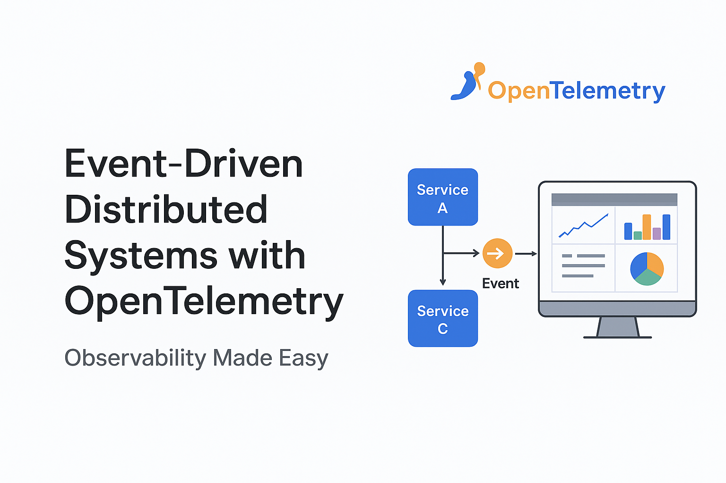

Slide 2
AGENDA
What is Event Driven Arch.
Challenges in EDA
Why Observability Matters
What is Open Telemetry
What Otel does
Benefits of Otel
Demo

Slide 3
Event-Driven Distributed Systems

Slide 4
What is Event Driven Arch. - EDA
Design Pattern where components Communicated via Events
Loosely-coupled services communicating via events/messages.
Promotes scalability and decoupling.
Key concepts:
Event Producer: The component that publishes an event. It doesn't know who will consume the event.
Event Consumer: The component that subscribes to and processes an event. It doesn't need to know where the event came from.
Event Channel/Broker: The intermediary that holds events and routes them to consumers. This decouples the producers and consumers.
Notes:
software design pattern where components communicate through the production, detection, and consumption of events. An event is a significant change in state. Think of it like a newspaper subscription: a publisher (the event producer) writes an article (the event), and all subscribers (the event consumers) who are interested get a copy. The producers and consumers don't need to know about each other directly.

Slide 5
Challenges in EDA
While powerful, EDA introduces complexities that can make debugging difficult.
Distributed Complexity
Black Box Problem
Debugging Nightmare
Visibility Gap
Notes:
While powerful, EDA introduces complexities that can make debuggingdifficult. Distributed Complexity: Events can flow through many differentservices, making it hard to follow the complete path of a request.
Black Box Problem: It's difficult to see what's happening inside theevent broker and know if events are being processed correctly.
Debugging Nightmare: You can't just trace a single request fromstart to finish. A single event might trigger a cascade of other eventsacross different services at different times.
Visibility Gap: Without a single, unified view, it's challenging toanswer simple questions like, "What services were involved inprocessing this user's order?" or "Why did this order fail?"

Slide 6
Observability

Slide 7

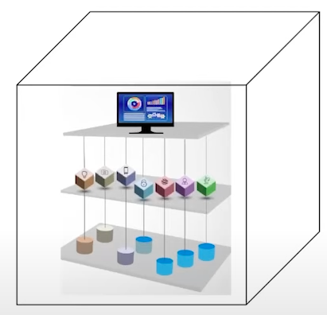
Why Observability Matters ?
Modern systems are complex and distributed
Without observability, systems are like black boxes
With observability, systems become glass boxes Observability vs. Monitoring:
Monitoring tells you if your system is working (e.g., "Is the server up?").
Observability helps you understand why it's not working (e.g., "Why is this specific service request failing?").
Notes:
black box
no idea what's going on inside so if something goes wrong it's going to be more difficult and more time consuming to solve the problem
with observability we turn this black box into a glass box as a matter of fact it helps you collect the data necessary to visualize and understand what's going on in your system
Monitoring tells you if your system is working (e.g., "Is the server up?").
Observability helps you understand why it's not working (e.g., "Why is this specific service request failing?").

Slide 8
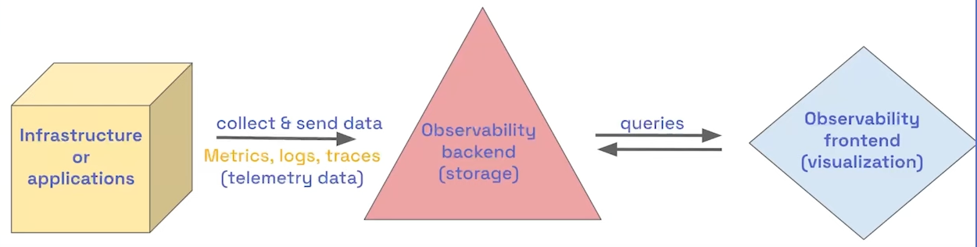
How to make into glass box
Notes:
Metrics: Numerical data representing a system over time (e.g., CPU usage, request count).
Instead of looking at 100s of logs
We should not expose too many metrices Cost ineffective and overburdens
Logs: Timestamped text records of discrete events (e.g., error messages).
Should be easily readable to Human as well as to machines
Traces: End-to-end views of requests as they flow through a distributed system.
Getting data into the back end is an important part of understanding our infrastructure or applications and this is where otel comes in

Slide 9
Open-Telemetry

Slide 10
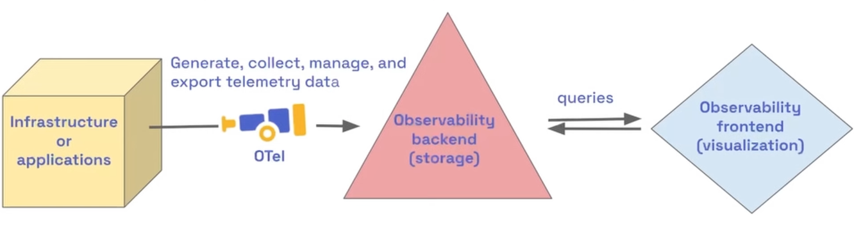
What is Open Telemetry
Notes:
Open Source Framework Generating the telemetry data is called as Instrumentation Handles instrumentation and telemetry generation.
Exports data to any backend that accepts OpenTelemetry standard.
Does NOT handle storage or visualization itself — it leaves that to tools like Grafana, Jaeger, etc.

Slide 11
What is Open Telemetry
Open Source Framework
Focused on generation, collection and export of telemetry data
Language, Infrastructure or environment agnostic
Storage and visulization is intentionally left out
Notes:
Open Source Framework Generating the telemetry data is called as Instrumentation Handles instrumentation and telemetry generation.
Exports data to any backend that accepts OpenTelemetry standard.
Does NOT handle storage or visualization itself — it leaves that to tools like Grafana, Jaeger, etc.

Slide 12
Why Otel
Problem Without OTel:
Each observability vendor (A, B, C) uses proprietary agents and collectors.
Switching vendors means re-instrumenting everything (time-consuming and costly).
You become locked into a single vendor.
Benefit of OTel:
Write instrumentation once using OTel standards.
Send telemetry data to any vendor/backend that supports OTel.
Freely switch vendors with lower switching costs.
Own your data.
Notes:
Just like USB-C replaced proprietary charging cables, OTel aims to be a universal telemetry standard.

Slide 13
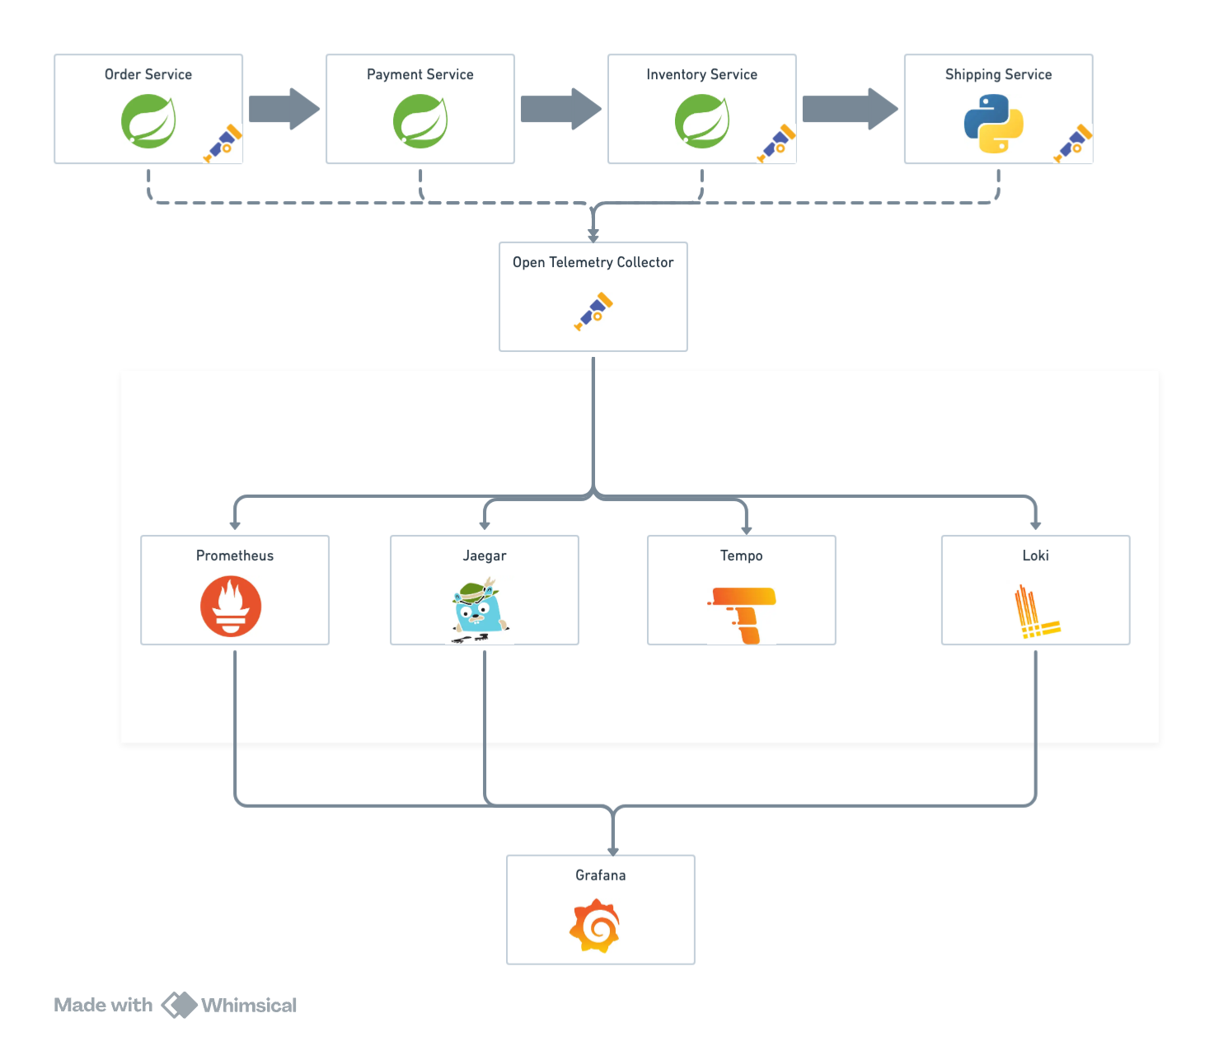

Slide 14
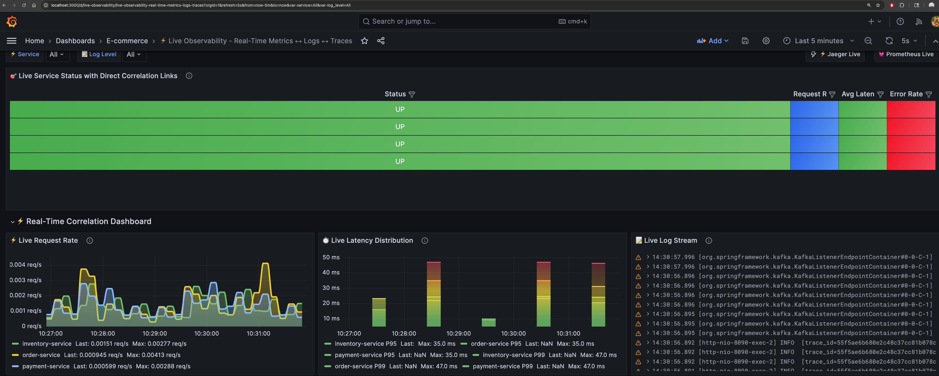
Grafana Dashboard

Slide 15
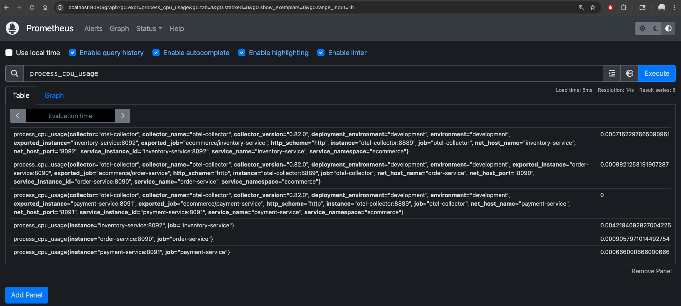
Prometheus - Metrices

Slide 16
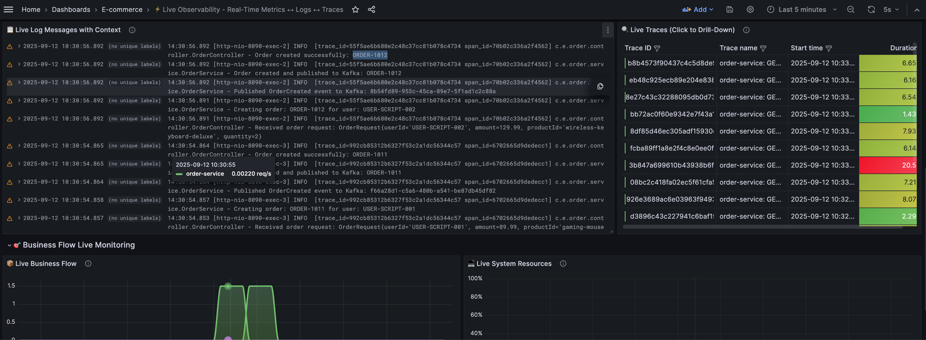
LOKI - Logs

Slide 17
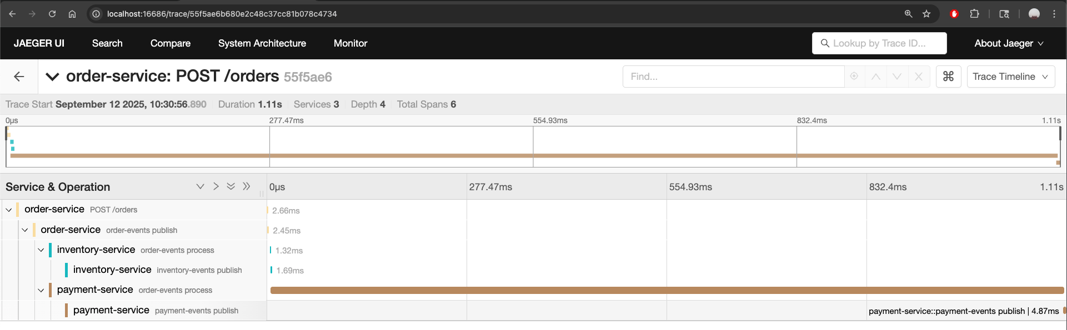
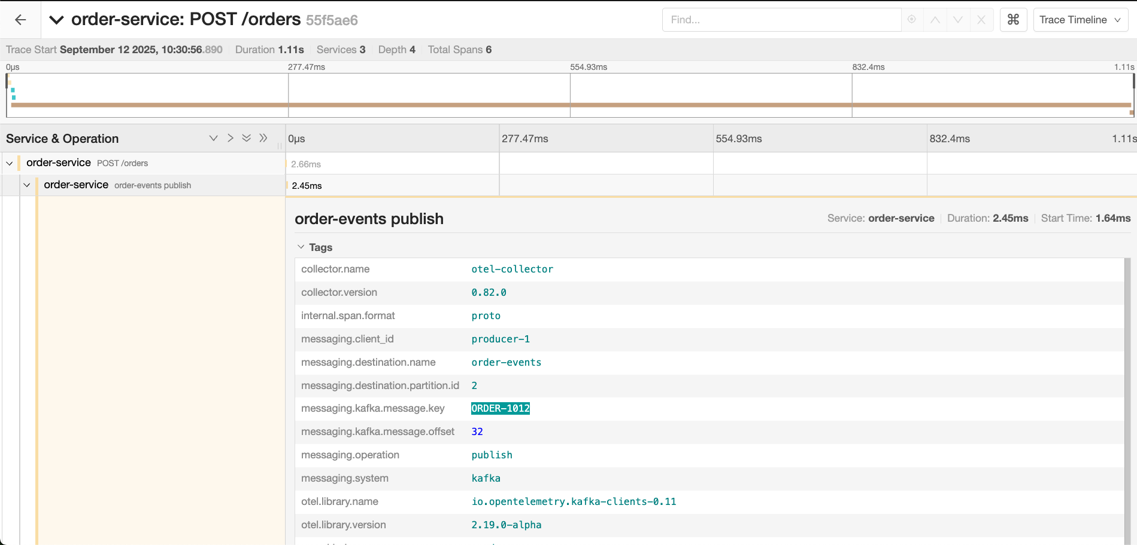

Slide 18
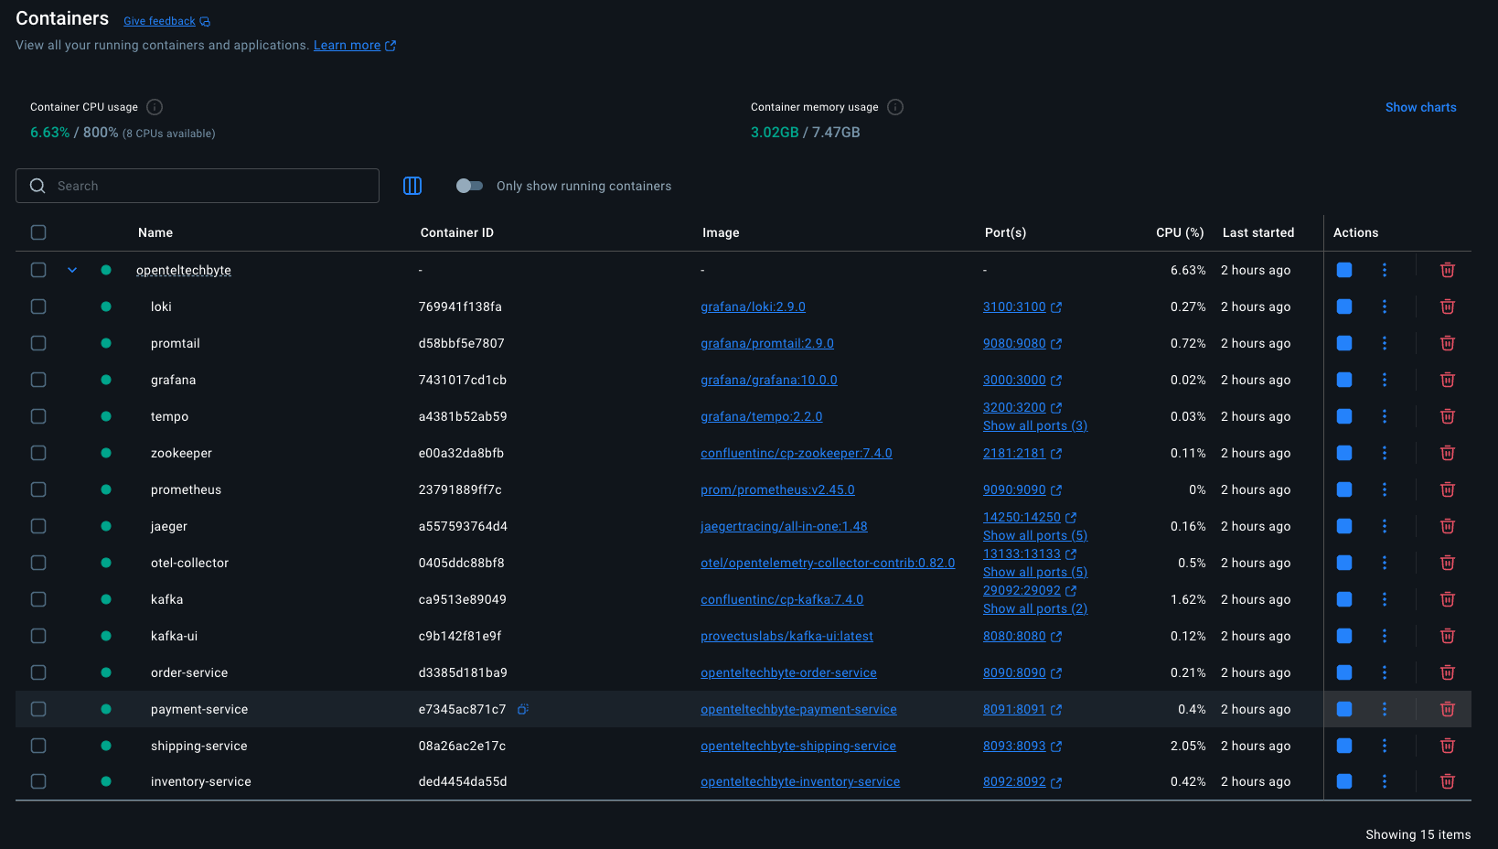
Docker Containers

Slide 19
THANK YOU
Chetan G

